Slide 1
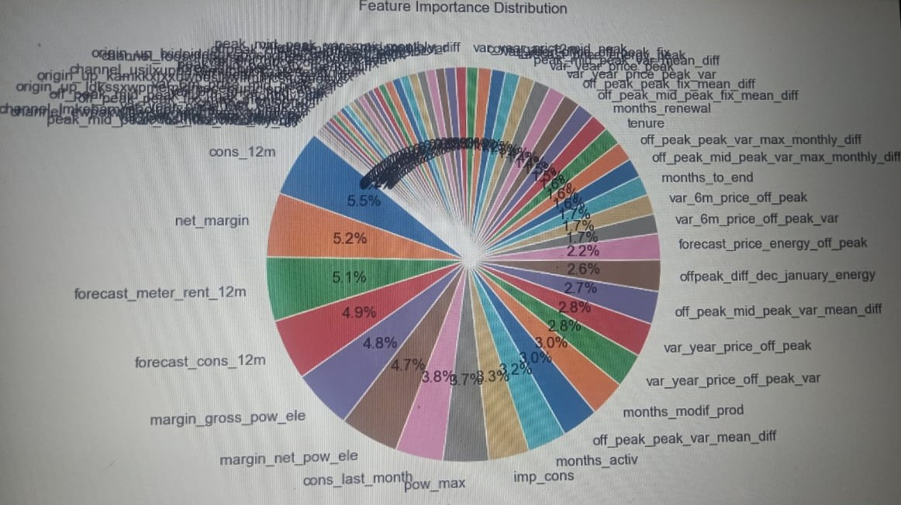
Executive summary best practice
From the model, we have insights for PowerCo’s problem of customer churn.
As per our evaluation: -
1.Electricity consumption in the past 12 months is the biggest determining factor of customer churn.
2. This is followed by net margin,Forecast Meter Rental, forecast consumption in past 12 month
3. Hike in prices is not the reason for customer churn.
A good executive summary provides all the key information in one slide
Consultants typically communicate in a “top down” or pyramid fashion, starting with the conclusion and then providing the supporting information
The goal is to communicate as much information in as few words as possible

